Slide 1
Business Data Communications & Networking
Chapter 2
Application Layer

Slide 2
Outline
Application Architectures
The Web
Email
Other Application-Layer Protocols
Implications for Management

Slide 3
Application Layer
Internet Model
Layer 5 in the Internet model
The software that enables users to interact with the network and accomplish tasks

Slide 4
Application Architecture
The way the functions of the application layer are spread out across the client and server
Four components of applications:
  Presentation logic
  Application logic
  Data access logic
  Data Storage

Slide 5
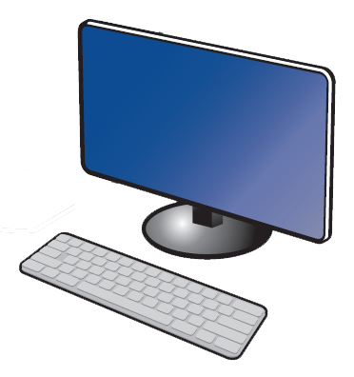
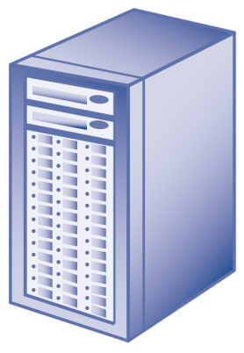
Host-Based Architecture
Server contains all components (“server-based”)
Common in the 1960s with mainframes and terminals
CLIENT
SERVER
Presentation Logic
Application Logic
Data Access Logic
Data Storage

Slide 6
Host-Based Architecture
Advantages
  Very simple
  Single point of control
Disadvantages
  Host (server) can become a bottleneck
  Upgrades typically expensive

Slide 7
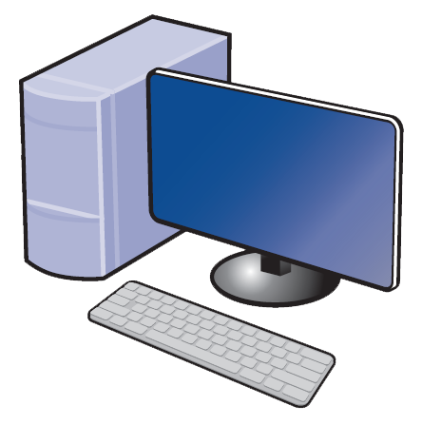
Client-Based Architecture
Client contains presentation, application, and data access logic
Most common in the 1980s
CLIENT
SERVER
Presentation Logic
Application Logic
Data Access Logic
Data Storage

Slide 8
Client-Based Architecture
Advantages
  Hardware and applications less expensive
  Simple architecture
Disadvantages
  Data must travel back and forth between server and client

Slide 9
Client-Server Architecture
Most common architecture today
OR
CLIENT
SERVER
Presentation Logic
Application Logic
Application Logic
Data Access Logic
Data Storage

Slide 10
Client-Server Architecture
Thin clients are easier to manage, thick clients have more functionality
Thick-Client Architecture
Thin-Client Architecture
CLIENT
SERVER
CLIENT
SERVER
Presentation Logic
Application Logic
Data Access Logic
Data Storage
Presentation Logic
Application Logic
Data Access Logic
Data Storage

Slide 11
Client-Server Architecture
Advantages
  More efficient because of distributed processing
  Allows hardware/software from different vendors to be used together
  Less bandwidth required
Disadvantages
  May be challenges in configuring hardware/software from different vendors to work together
  In many cases, middleware is required

Slide 12
Client-Server Architecture
Middleware is software acts as an intermediary by “sitting between” client and server applications
Provides a standard way of translating between software from different vendors
Manages message transfers
Insulates network changes from the clients (e.g., adding a new server)

Slide 13
Client-Server Architecture
three-tier
two-tier
n-tier
Example of architecture
Application SERVER
Application SERVER
Database SERVER
Database SERVER
Web SERVER
CLIENT
SERVER
Presentation Logic
Application Logic
Data Access Logic
Data Storage
Application Logic
Data Access Logic
Data Storage
Data Access Logic
Data Storage

Slide 14
Tiered Client-Server Architecture
Advantages
  Load balancing
  More scalable
Disadvantages
  Each tier increases network load
  More complex and difficult to develop applications

Slide 15
Peer-to-Peer Architecture
An older architecture that became popular again with Napster, BitTorrent, etc.
All devices can act as client and server
CLIENT/SERVER
CLIENT/SERVER
Presentation Logic
Application Logic
Data Access Logic
Data Storage
Presentation Logic
Application Logic
Data Access Logic
Data Storage

Slide 16
Peer-to-Peer Architecture
Advantages
  Resilient to failure
  Data can be stored anywhere on network
  Distributes bandwidth requirements
Disadvantages
  Finding the stored data
  Security

Slide 17
Cloud Computing
Cloud Computing is the general term for enabling access to computing services over the network (most commonly the Internet)
Models of cloud computing define who manages each application function and associated hardware/software

Slide 18
Cloud Computing
Cloud Computing Models
  Software as a Service (SaaS)
    All application components and associated hardware/software outsourced
    Based on multitenancy
    e.g. Salesforce.com
  Platform as a Service (PaaS)
    Application logic and data are managed internally
    e.g., Microsoft Azure
  Infrastructure as a Service (IaaS)
    All hardware is outsourced

Slide 19
Cloud Computing
 | Traditional Thin-Client Client-Server |  | Infrastructure as a Service (IaaS) |  | Platform as a Service (Paas) |  | Software as a Service (SaaS)
 | Internal | Outsourced | Internal | Outsourced | Internal | Outsourced | Internal | Outsourced
Application Logic | X |  | X |  | X |  |  | X
Data Storage | X |  | X |  | X |  |  | X
Data Access Logic | X |  | X |  |  | X |  | X
Operating System | X |  | X |  |  | X |  | X
Virtualization Software | X |  | X |  |  | X |  | X
Server Hardware | X |  |  | X |  | X |  | X
Storage Hardware | X |  |  | X |  | X |  | X
Network Hardware | X |  |  | X |  | X |  | X

Slide 20
Criteria for Choosing Architecture
Infrastructure
  Cost of servers, clients, and circuits
  Reliability
Development Costs
  Software; cheaper on host-based architectures
Scalability
  Ability to increase (or decrease) in computing capacity as network demand changes
  Easier in client-server architectures

Slide 21
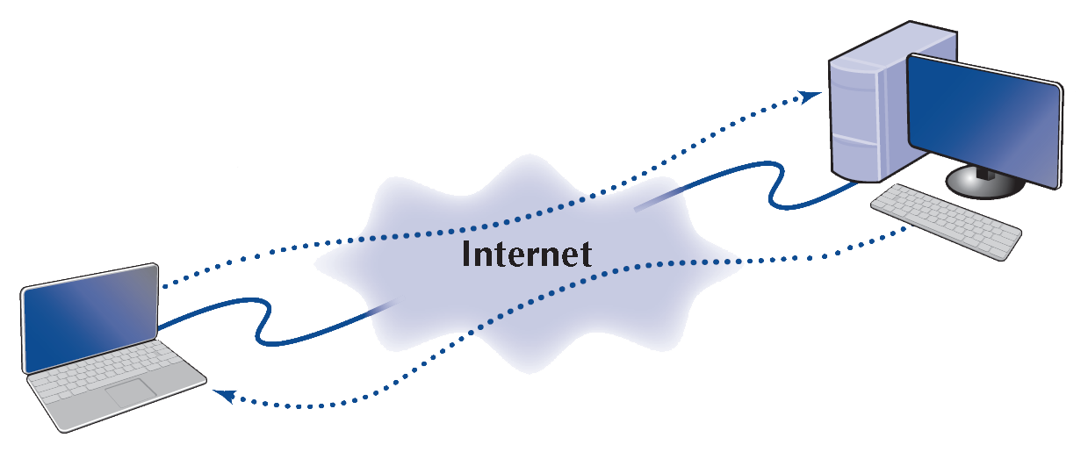
The Web
Hypertext Transfer Protocol (HTTP)
HTTP Request and Response
Client computer with Web browser software
HTTP Response
Web Server
HTTP Request

Slide 22
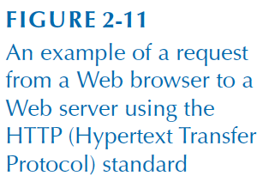
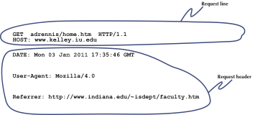
The Web
HTTP Request

Slide 23
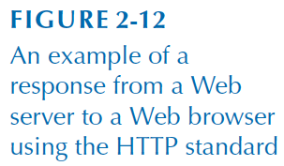
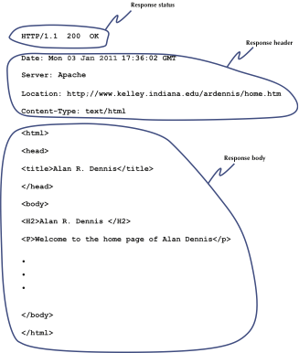
The Web
HTTP Response

Slide 24
Email
Mail Transfer Agent (MTA)
  Formal name for mail server software
  e.g., Sendmail, Postfix,
Mail User Agent (MUA)
  Formal name for mail client software
  e.g., Outlook, Apple Mail, Thunderbird
Simple Mail Transfer Protocol (SMTP)
  Protocol used to send a message to a MTA
  Originally only handled text files
Internet Message Access Protocol (IMAP) or Post Office Protocol (POP)
  Protocols used by a MUA to retrieve messages from an MTA
American Standard Code for Information Interchange (ASCII)
  A standard for encoding text characters (a-z, A-Z, 0-9, a few symbols)

Slide 25
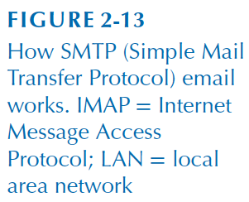
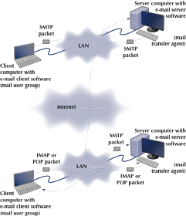
Email

Slide 26
Email
How a message is sent (2-tier, thick client)
Sending Client → Sender’s Mail Server (SMTP)
Sender’s Mail Server → Receiver’s Mail Server (SMTP)
Message waits on Receiver’s Mail Server in “mailbox”
Receiving Client → Receiver’s Mail Server (IMAP or POP)
Receiver’s Mail Server → Receiving Client (IMAP or POP)

Slide 27
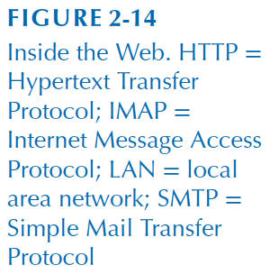
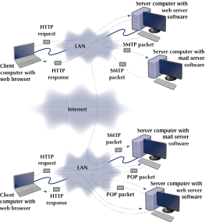
Email

Slide 28
Email
How a message is sent via webmail (3-tier, thin client)
  Sending Client → Sender’s Web Server (HTTP)
  Sender’s Web Server → Sender’s Mail Server (SMTP)
  Sender’s Mail Server → Receiver’s Mail Server (SMTP)
  Mail waits on Receiver’s Mail Server in “mailbox”
  Receiving Client → Receiver’s Web Server (HTTP)
  Receiver’s Web Server → Receiver’s Mail Server (IMAP or POP)
  Receiver’s Mail Server → Receiver’s Web Server (IMAP or POP)
  Receiver’s Web Server → Receiving Client (HTTP)

Slide 29
Email
SMTP Message Format
  RFC 822: Standard for text message format
Header lines
  Contain information about the message such as To, From, and Subject
Body section
  Contains the “content of the message
  Begins with the “DATA” keyword
  Only uses ASCII characters
Header
Body

Slide 30
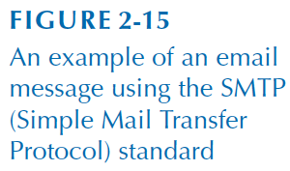
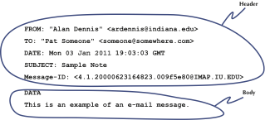
Email
Inside an SMTP packet
  Header: source, destination, date, subject, etc.
  Body: keyword “DATA”, then email message

Slide 31
Email
SMTP is a simple protocol to send plain text
Not designed to send images or attachments
Multipurpose Internet Mail Extension (MIME)
  A standard to extend support for attachments and non-ASCII characters in email
  Used by sender to convert (encode) any non-ASCII content into ASCII
  Receivers then convert (decode) the ASCII back to its original format

Slide 32
Other Application-Layer Protocols
File Transfer Protocol (FTP) - for moving files between clients and servers
Telnet, Secure Shell (SSH) - for executing commands on a remote system
Internet Relay Chat (IRC), Extensible Messaging and Presence Protocol (XMPP) - for real-time text chat (instant messaging)
Domain Name System (DNS) - for mapping domain names to IP addresses

Slide 33
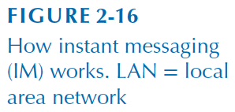
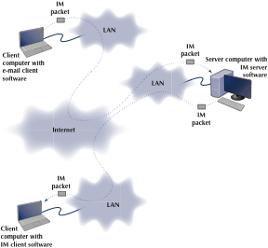
Instant Messaging

Slide 34
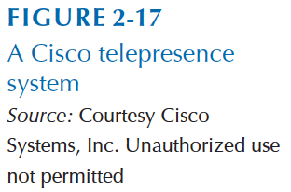
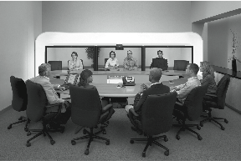
Video Conferencing

Slide 35
Implications for Management
Primary purpose of networks is to provide environment for applications
The number and types of applications on the network is dramatically increasing

