Slide 1
Chapter 5
Responsive Design Part 1: Designing for Mobile Devices

Slide 2
Chapter Objectives
You will have mastered the material in this chapter when you can:
  Explain the principles of responsive design
  Describe the pros and cons of a mobile website
  Explain the design principles of a mobile website
  Describe a mobile-first strategy
  Define a viewport
  Insert a meta viewport element

Slide 3
Chapter Objectives (continued)
  Use a mobile simulator
  Create a sticky element
  Integrate custom fonts
  Use a pseudo-class
  Create a mobile-friendly navigation system
  Add a telephone link
  Make rounded corners

Slide 4
Introduction
Responsive design is a website development strategy that strives to provide an optimal user experience of a website regardless of the device used
  By applying responsive design principles, the webpage and content respond to the screen size of the user’s device
    Minimizes unnecessary scrolling and zooming, making reading and interacting with the site as convenient and intuitive as possible

Slide 5
Project — Redesign a Website for Mobile Devices
Roadmap
  ADD a META VIEWPORT ELEMENT to each HTML document
  CREATE a STICKY HEADER
  ADD CUSTOM FONTS
  STYLE PAGES FOR a MOBILE VIEWPORT
  STYLE the MAP FOR a MOBILE VIEWPORT

Slide 6
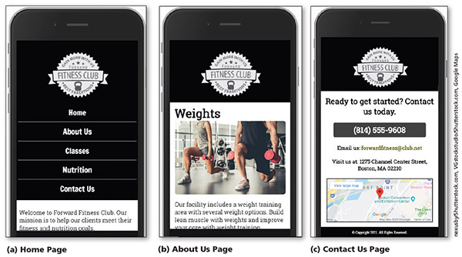
Project — Redesign a Website for Mobile Devices (continued)
Figure 5–1

Slide 7
Exploring Responsive Design
Content is easy to read and navigate on devices of three sizes: desktop browser, tablet, and phone
Philosophy that is constantly refined as HTML and CSS standards, browsers, and technology evolve and improve

Slide 8
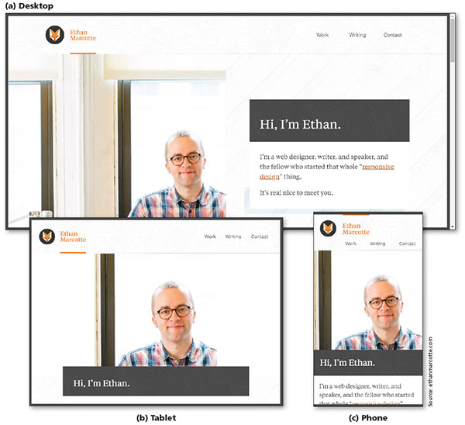
Exploring Responsive Design (continued 1)
Figure 5–2

Slide 9
Exploring Responsive Design (continued 2)
Fluid layout
  Applies proportional size measurements to the webpage wireframe and content
  The viewport is the viewing area for the webpage; refers to the area of the webpage that a user sees at any one time, regardless of device, browser, screen size, screen resolution, window size, or orientation

Slide 10
Exploring Responsive Design (continued 3)
Responsive or flexible images
  Shrink and grow based on the size of the viewport
  Do not have height and width attributes or values in the HTML document
  Use CSS rules to resize the image relative to the wireframe and viewport

Slide 11
Exploring Responsive Design (continued 4)
Media queries
  Allow the webpage developer to detect the approximate pixel size of the current viewport
  Allow the developer to selectively apply CSS rules that work best for that viewport size

Slide 12
Designing for Mobile Devices
Mobile website
  Completely separate, parallel website optimized for mobile users to address problems with viewports
  Identified with an m. or mo. prefix in the URL
  Optimizes the viewing experience for a wide range of devices using one website
  Major downside: multiplies the work required to maintain what becomes two separate websites for the same organization

Slide 13
Designing for Mobile Devices (continued 1)
Mobile-first strategy
  Employs responsive design principles
    Web developer designs the flexible wireframe and essential content for the smallest viewport first, progressively adding more content as the viewport grows
    Media queries are used to add styles for progressively larger viewports, progressing from tablet to laptop and desktop
  More productive and effective way to build a website from scratch

Slide 14
Designing for Mobile Devices (continued 2)
Implementation of the website development approach depends on many factors
  Current environment
  Target audience
  Available resources
  Time available to tackle the project

Slide 15
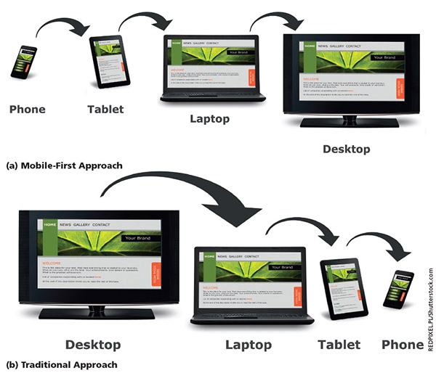
Designing for Mobile Devices (continued 3)
Figure 5–3

Slide 16
Using Responsive Design
Webpage with a fluid layout adjusts the webpage design and content based on the size of the viewport
  Responsive designs are based on fluid layouts
Fixed layouts do not change in width based on the size of the viewport
  Use fixed measurement units such as pixels to define the width of the areas of the wireframe that “fix” the width of the content regardless of the size of the viewport

Slide 17
Creating a Fluid Layout
A fluid layout requires a fluid grid, media queries, and responsive images
  To create a fluid grid, you design a webpage that uses a grid or columns
  A mobile viewport should use a single-column design, which is ideal for a smaller viewport
  As the viewport’s size increases, the number of columns can also increase

Slide 18
Following a Mobile-First Strategy
It is better to use a single-column layout for a mobile display as this prevents scrolling horizontally
  Displaying what mobile device users need and want on a single screen with minimal scrolling creates a more enjoyable experience
Styling content for mobile devices requires that each page be analyzed
  Determine the most important content on the page and style that content

Slide 19
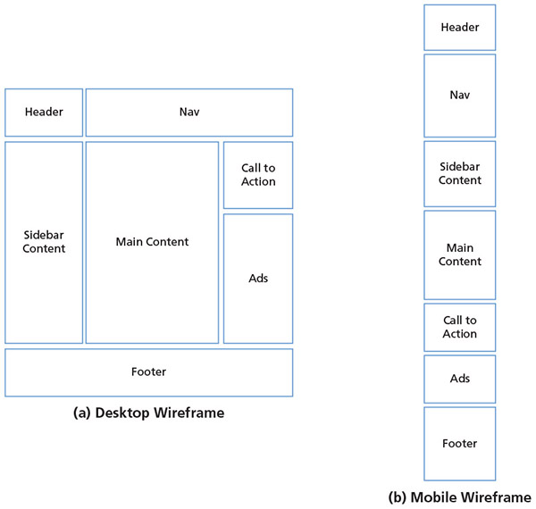
Following a Mobile-First Strategy (continued 1)
Figure 5–8

Slide 20
Following a Mobile-First Strategy (continued 2)
Some key practices when designing for mobile viewports
  Make use of 100% of the screen space
  Design the navigation to be easy and intuitive
  Keep load times minimal
  Display essential page content and hide nonessential page content
  Make the content easy to access and read
  Design a simple layout

Slide 21
Following a Mobile-First Strategy (continued 3)
When creating a website with a responsive design, a meta viewport element must be included within every HTML file
  Provides the browser with information about the page’s dimensions and how to adjust scaling on the webpage
A mobile simulator displays an example of how a website would appear on a mobile device
  Many available online

Slide 22
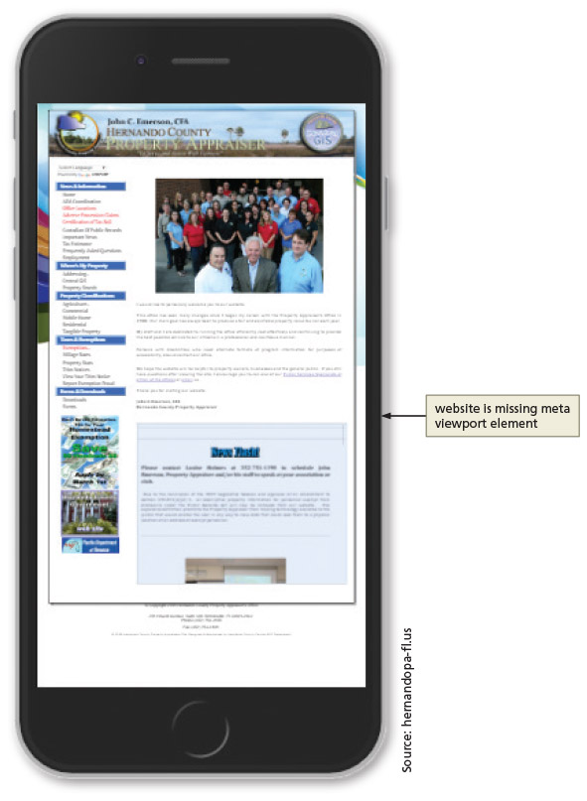
Following a Mobile-First Strategy (continued 4)
Figure 5–10

Slide 23
Following a Mobile-First Strategy (continued 5)
Steps in a mobile-first strategy
  First, analyze each page to determine the most essential content and whether to hide some of the content on a mobile device
Depending on the design, you may want the company name or logo to remain at the top of the webpage as the user scrolls down
  To accomplish this task, you create a fixed or sticky header, known as a sticky element

Slide 24
Following a Mobile-First Strategy (continued 6)
The navigation system for a website can look different in each viewport
  Many mobile viewport designs use a hamburger button or icon to display or toggle a navigation system
Typography is a design element to consider when designing a website
  Today, many custom fonts can be used by downloading them onto web servers or by linking to them in HTML files

Slide 25
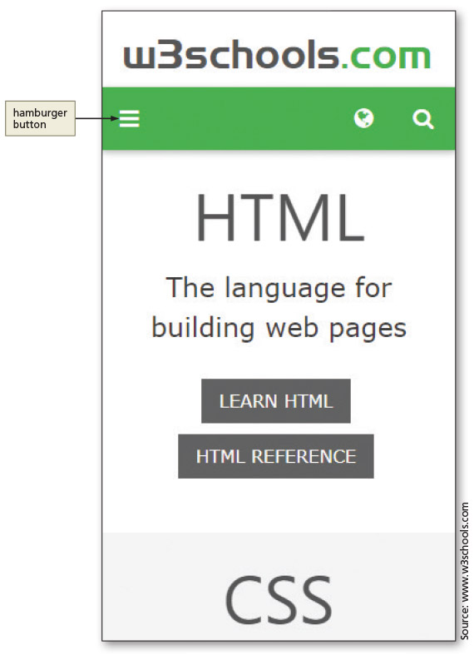
Following a Mobile-First Strategy (continued 7)
Figure 5–21

Slide 26
Following a Mobile-First Strategy (continued 8)
A pseudo-class can be used with a selector to specify the state of an element
  For example, you can specify a style to apply when a mouse hovers over an element
Essential information can be added to the home page without removing the content for webpage visitors with a desktop device
  The div element is used to accomplish this task

Slide 27
Following a Mobile-First Strategy (continued 9)
By default, element borders use a 90-degree angle at each corner
  You can see the angle when you specify a border all around an element
    Images also have a default 90-degree angle at each corner
    Change default appearance by applying rounded corners with CSS
    CSS property to round corners is border-radius

Slide 28
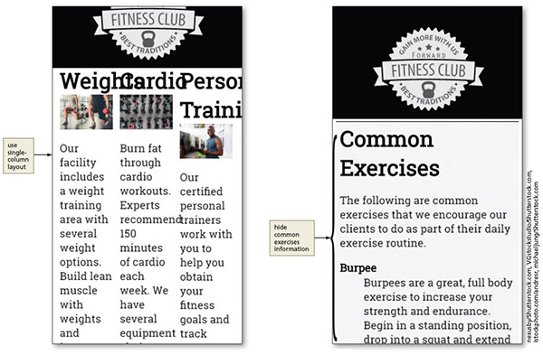
Analyze the About Us Page for Mobile-First Design
Figure 5–52

Slide 29
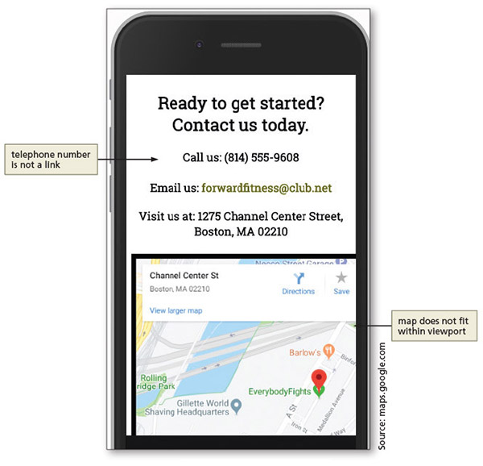
Analyze the Contact Us Page for Mobile-First Design
Figure 5–58

Slide 30
Mobile-Friendly Test
Once you have completed your design for a mobile viewport, view and test it on as many smartphone devices as possible
  Google Chrome’s device mode is helpful during the design process
  Testing on an actual device is optimal

Slide 31
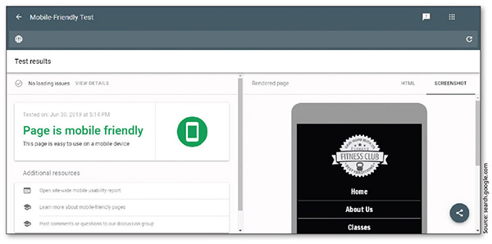
Mobile-Friendly Test (continued)
Figure 5–63

Slide 32
Chapter Summary
In this chapter, you learned how to apply responsive design principles to a website
  Modified the fitness website to use a fluid layout
  Added a meta viewport element
  Followed a mobile-first strategy to analyze and modify the webpages in the fitness website
  Integrated custom fonts
  Created a sticky element and a responsive navigation system for a mobile viewport
  Used a pseudo-class
  Added rounded corners

