Slide 1
Business Data Communications & Networking
Chapter 4
Data Link Layer

Slide 2
Outline
Data Link Layer
Media Access Control
Controlled Access
Contention Access
Error Control
Prevention
Detection
Correction
Protocols
Async
SDLC
Ethernet
PPP
Transmission Efficiency and Throughput
Implications for Management

Slide 3
Data Link Layer
Internet Model
Layer 2 in the Internet model
Responsible for moving messages from one device to another
Controls the way messages are sent on media
Organizes physical layer bit streams into coherent messages for the network layer
Major functions of a data link layer protocol
Media Access Control
Error Control
Message Delineation

Slide 4
Outline
Media Access Control
Controlled Access
Contention Access
Error Control
Prevent
Detect
Correct
Protocols
Message Delineation
Ethernet
PPP
Transmission Efficiency

Slide 5
Media Access Control
Controls which device transmits and when
Important on
Multipoint (shared) circuits
Half-duplex point-to-point circuits
Two approaches to control
Contention access
Controlled access

Slide 6
Media Access Control
Contention
Transmit whenever circuit is available with no centralized control
Common in Ethernet LANs
When devices transmit at the same time, a collision occurs
Devices must be “polite” and follow these steps:
“Listen” for traffic
If another device is transmitting, wait to transmit
Otherwise, transmit (and keep listening)
If another device begins to transmit, stop and wait

Slide 7
Media Access Control
Controlled access
Common in wireless LANs
Access Request
Each device must get “permission” to transmit, similar to raising a hand
Polling
Roll-call polling
Central device (controller) determines which devices can transmit
Each client is checked periodically to see if it needs to transmit
Hub Polling (token passing)
One device begins the poll and then passes it to another device until it reaches them all

Slide 8
Media Access Control
With high traffic, controlled access is better because of the high collisions of contention.
With low traffic, the higher overhead of controlled access makes contention more efficient.
Cross-over point used to be 20 devices, but very much depends on devices, protocols, traffic, etc.

Slide 9
Error Control
Network errors
Types
Corrupted data
Lost data
Caused by problems in transmission (not humans)
Networks should be designed with:
Error prevention
Error detection
Error correction

Slide 10
Sources of Network Errors
Line noise and distortion
Major reason for errors and caused by several sources
More likely on electrical media
Undesirable electrical signal
Degrades performance of a circuit
Manifestation
Extra bits
“Flipped” bits
Missing bits

Slide 11
Error Prevention
Source of Error | What Causes It | How to Prevent or Fix
White Noise | Movement of electrons | Increase signal strength
Impulse Noise | Sudden increases in electricity (e.g., lightning) | Shield or move the wires
Cross-talk | Multiplexer guardbands too small or wires too close together | Increase the guardbands or move or shield the wires
Echo | Poor (misaligned) connections | Fix the connections or tune equipment
Attenuation | Gradual decrease in signal over distance | Use repeaters
Intermodulation noise | Signals from several circuits combine | Move or shield the wires

Slide 12
Error Detection
Receivers need to know when the data transmitted is not correct
Add “check value” (error detection value) to message
Check value produced by mathematical formula
Message
Check Value

Slide 13
Error Detection
Both sender and receiver calculate check value
Sender tests whether the check values match
Sender
Receiver
Message
Check Value
Message
Check Value
Mathematical Calculations
Mathematical Calculations

Slide 14
Error Detection
Parity check
1-bit check value
Based on the number of 1’s in the message
Even parity: number of 1’s remains even
Odd parity: number of 1’s remains odd
Simple, but only detects 50% of errors
Example (Even Parity)
Character: ‘A’
Binary: 01000001
Parity Bit: 0
Character: ‘C’
Binary: 01000011
Parity Bit: 1

Slide 15
Error Detection
Checksum
1-byte (typically) check value
Checksum algorithms vary in the creation of check values
Detects 95% of errors

Slide 16
Error Detection
Cyclic redundancy check (CRC)
Treats message as a single binary number
Divides by a preset number
Uses remainder as the check value
Preset number is chosen so that remainder is the correct number of bits
Modes:
CRC-16 (~99.998% error detection rate)
CRC-32 (>99.99999% error detection rate)

Slide 17
Error Correction
Once detected, errors must be corrected
Error correction techniques
Retransmission (or backward error correction)
Retransmission is simple and most common
Automatic Repeat reQuest (ARQ)
Stop-and-wait ARQ
Continuous ARQ
This can also provide flow control by limiting the number of messages sent
Forward error correction
Receiving device can correct messages without retransmission

Slide 18
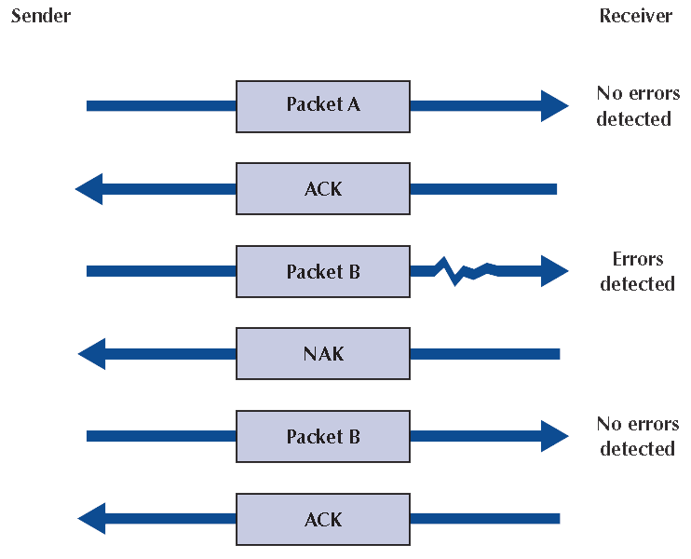
Error Correction
Stop-and-wait ARQ
Receiver receives frame and sends:
Acknowledgement (ACK) if no error
Negative acknowledgement (NAK) if error
If NAK, sender re-sends data
Frame 1
ACK
Frame 2
NAK
Frame 2
ACK

Slide 19
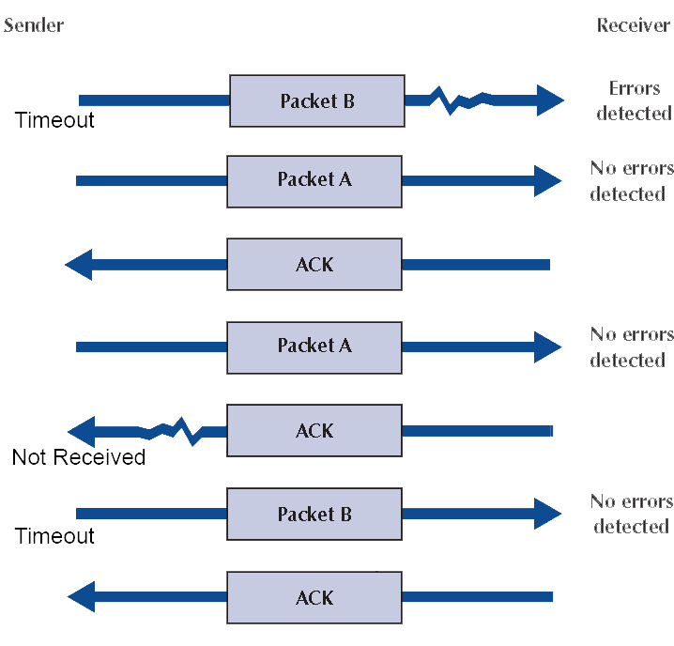
Error Correction
Stop-and-wait ARQ
If no ACK or NAK, Sender retransmits frame after “timeout”
If no ACK, sender re-sends data, receiver sends ACK and deletes duplicate frame
Frame 3
Frame 3
ACK
Frame 4
ACK
Frame 4
Duplicate Deleted
ACK

Slide 20
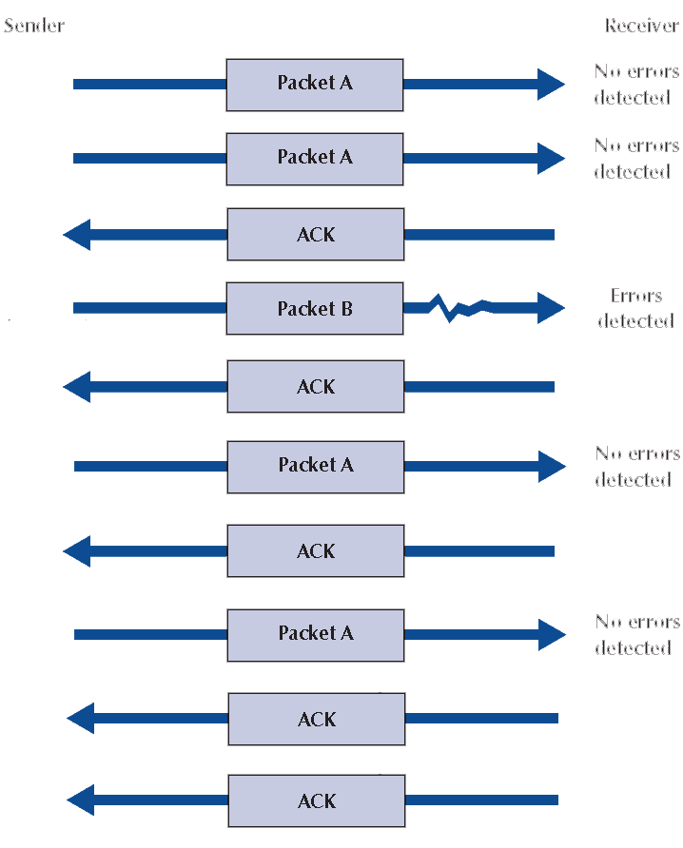
Error Correction
Sender
Receiver
Continuous ARQ
Sender does not wait for ACKs before sending more data
“Sliding window” is number of frames allowed to be unacknowledged by receiver
Agreed upon by sender and receiver
Frame 1
No errors detected
Frame 2
No errors detected
ACK 1
Frame 3
Errors detected
ACK 2
Frame 4
No errors detected
NAK 3
Frame 3
No errors detected
ACK 4
ACK 3

Slide 21
Error Correction
Forward error correction
Includes a certain level of redundancy in transmitted data so that receiving device can correct errors
Does not require retransmission
Used only when retransmission is impossible, very costly, or time consuming (e.g., satellite connections)

Slide 22
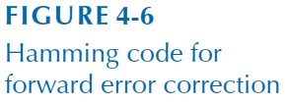
Error Correction - Hamming Code
Each data bit figures into three EVEN parity bit calculations
If any one bit (parity or data) changes → change in data bit can be detected and corrected
Only works for one bit errors

Slide 23
Error Correction
Error control in practice
On wired connections, errors are quite rare
Most data link layer software today does not correct errors, only detect them and discard frames with errors
Error correction must then be done at a higher layer (Transport)

Slide 24
Data Link Protocols
Classification
Asynchronous transmission
Synchronous transmission
Protocols differ by
Message delineation
Frame length
Frame field structure

Slide 25
Data Link Protocols
Asynchronous serial transmission (async)
Old protocol (e.g., used in teletype)
Transmits one character at a time
Delineation indicated by start and stop bits
Start Bit
(1 bit)
Message
(7 or 8 bits)
Parity
(1 bit)
Stop Bit
(1 bit)

Slide 26
Data Link Protocols
Synchronous transmission
Data sent in a large block called a frame
Includes addressing information
Includes synchronization characters to let the receiver know when data transmission begins
Example protocols: SDLC, HDLC, Ethernet, PPP

Slide 27
Data Link Protocols
Synchronous Data Link Control (SDLC)
Synchronous bit-oriented protocol developed by IBM
Uses bit stuffing (zero insertion) to overcome transparency problem
Flag
(8 bits)
Address
(8 bits)
Control
(8 bits)
Data
(variable)
CRC-32
(32 bites)
Flag
(8 bits)

Slide 28
Data Link Protocols
Ethernet
IEEE 802.3 standard and Ethernet II
Most widely used LAN protocol
Uses contention media access control
Ethernet II Frame
Interframe Gap
(12 bytes)
Preamble & Delimiter
(8 bytes)
Destination Address
(6 bytes)
Source Address
(6 bytes)
Type
(2 bytes)
Data
(46-1500 bytes)
CRC
(4 bytes)
38 Total Bytes of Overhead

Slide 29
Data Link Protocols
Point-to-point protocol (PPP)
Common WAN protocol
Flag
(1 byte)
Address
(1 byte)
Control
(1 byte)
Protocol
(2 bytes)
Data
(variable)
CRC
(2 or 4 bytes)
Flag
(1 byte)

Slide 30
Transmission Efficiency
Protocol design contributes to network efficiency
Transmission Efficiency
$$=\frac{\# of information bits \left(or bytes\right)}{\# of information+overhead bits (or bytes)}$$
Async Effiency = 8/(8+3) = 0.73 = 73%
How can we increase efficiency?
Increase Data bits
Decrease Overhead bits
What is the efficiency if you send 342 bytes over Ethernet II?
What is the efficiency if you send 722 bytes over Ethernet II?

Slide 31
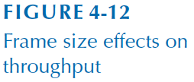
Data Link Protocols

Slide 32
Throughput
More complicated than simple protocol efficiency because it depends on the retransmission rate, transmission rate, and delay
Transmission Rate of Information Bits (TRIB) is a measure of the effective # of bits transmitted in a unit of time

Slide 33
Throughput
TRIB = $\frac{K(M−C)(1−P)}{\left(\frac{M}{R}\right)+T}$
K = information bits per character
M = frame length in characters
R = data transmission rate in characters/sec
C = average number of non-information characters per frame (control characters)
P = probability that a frame will require retransmission
T = time delay between frames (in seconds)

Slide 34
Implications for Management
Industry has seen a rapid consolidation in the number of data link layer protocols
Use fewer, well-established protocols for simpler network management, greater access to trained experts, and less expensive equipment

