Slide 1
Business Data Communications & Networking
Chapter 5
Network and Transport Layers

Slide 2
Outline
Transport Layer Protocols
Network Layer Protocols
Transport Layer Functions
Linking to the application layer
Segmenting
Session Management
Network Layer Functions
Addressing
Routing
TCP/IP Examples
Implications for Management

Slide 3
Network and Transport Layers
Internet Model
Transport Layer
Layer 4 in the Internet model
Links application and network layers
Responsible for segmentation and reassembly
Session management
Responsible for end-to-end delivery of messages
Network Layer
Layer 3 in the Internet model
Responsible for addressing and routing of messages

Slide 4
Protocols
TCP/IP
Originally developed as a single internetworking protocol by Vint Cerf and Bob Kahn in 1974
Later divided into the TCP and IP protocols
Most common protocols of the Internet and in LANs, WANs, and backbone networks

Slide 5
Transport Layer Protocols
Transmission Control Protocol (TCP)
Most common transport layer protocol
PDU called a segment
Used for reliable transmission of data
160 - 192 bits (20 -24 bytes) of overhead
Options field is not required
Source Port
(16 bits)
Destination Port
(16 bits)
Sequence Number
(32 bits)
ACK number
(32 bits)
Header Length
(4 bits)
Unused
(6 bits)
Flags
(6 bits)
Flow Control
(16 bits)
CRC-16
(16 bits)
Urgent Pointer
(16 bits)
Options
(32 bits)
User Data
(varies)

Slide 6
Transport Layer Protocols
User Datagram Protocol (UDP)
Operates at the transport layer
PDU called a segment
Used in time-sensitive situations, for control messages, or when reliability is handled by the application layer
32-64 bits (4-8 bytes) of overhead
Source port is optional in IPv4 and IPv6, Checksum is optional in IPv4
Source Port
(16 bits)
Destination Port
(16 bits)
Length
(16 bits)
Checksum
(16 bits)
User Data
(varies)

Slide 7
Network Layer Protocols
Internet Protocol (IP)
IP version 4 (IPv4)
Most common version of IP used
32-bit addresses (2³² or ~4.29 billion possible)
Exhaustion of address space
IP version 6 (IPv6)
128-bit addresses (2¹²⁸ or ~3.4 × 10³⁸ possible)
Slowly being adopted due to IPv4 exhaustion

Slide 8
Network Protocols
IPv4 Packet
160-192 bits (20-24 bytes) of overhead
Options field rarely used
Version number
(4 bits)
Header length
(4 bits)
Type of service
(8 bits)
Total length
(16 bits)
IDs
(16 bits)
Flags
(3 bits)
Packet Offset
(13 bits)
Time to Live /
Hop Limit
(8 bits)
Protocol
(8 bits)
CRC-16
(16 bits)
Source Address
(32 bits)
Destination Address
(32 bits)
Options
(32 bits)
User Data
(varies)

Slide 9
Network Protocols
Optional Headers
IPv6 Packet
Fixed Header
320 bits (40 bytes) of overhead
Version number
(4 bits)
Traffic Class / Priority
(8 bits)
Flow Label
(20 bits)
Payload length
(16 bits)
Next Header
(8 bits)
Hop Limit
(8 bits)
Source Address
(128 bits)
Destination Address
(128 bits)
User Data
(varies)
Optional Headers
Hop-by hop options
Destination options (with routing options)
Routing
Fragment
Authentication
Encapsulation Security Payload
Destination options
Mobility

Slide 10
Transport Layer Functions
Linking to the application layer
TCP/UDP may serve multiple application layer protocols
Ports used to identify application (2-byte numbers)
Many source/destination ports follow standards
Common port standards
HTTP: TCP port 80
HTTPS: TCP port 443
FTP: TCP ports 20 and 21
SMTP: TCP port 25
IMAP: TCP port 143
POP3: TCP port 110 (more commonly TCP port 995 secure version)
DNS: TCP or UDP port 53 (most commonly UDP)

Slide 11
Transport Layer Functions

Slide 12
Transport Layer Functions
Segmenting
Breaking up large files into smaller segments (and putting them back together)
Segments may be passed individually to application layer or after reassembly
How large are the segments?
Size depends on the network and data link layer protocols
Maximum Segment Size (MSS) is negotiated during TCP handshake
e.g., if the maximum size of the data in an Ethernet frame is 1,500 bytes and TCP and IP use 20 byte headers, the maximum segment size is 1460 bytes
IPv4 header
Ethernet Frame Data Size
1500 – 20 – 20 = 1460 bytes
TCP header

Slide 13
Transport Layer Functions
 | Sender | PDU | Receiver
Application |  | Packet
Transport |  | Segment
Network |  | Packet
Data Link |  | Frame

Slide 14
Transport Layer Functions
Session management
A session can be thought of as a conversation between two computers or creating a virtual circuit
Using a session to send data is also called connection-oriented messaging (TCP)
Sending messages without establishing a session is connectionless messaging (UDP)
TCP connections are opened using a three-way handshake
SYN
SYN-ACK
ACK
Sessions provide reliable end-to-end connections

Slide 15
Network Layer Functions
Addressing
Used to direct messages from source to destination
Addresses are assigned in various ways (e.g., by system administrators, ICANN, hardware vendors, etc.)
Addresses exist at different layers
Addresses may be translated (resolved) from one layer to another (e.g., DNS, ARP)
Address Type | Example | Example Address
Application layer | Uniform Resource Locator (URL) | www.indiana.edu
Network layer | IP address | 129.79.78.193 (4 bytes)
Data link layer | MAC address | 1C-6F-65-F8-33-8A (6 bytes)

Slide 16
Network Layer Functions
Addressing
IPv4 addresses are 32 bits
Most common way to write is using dot-decimal notation
Easier for people to read and remember
Breaks the address into four bytes and writes each byte in decimal notation instead of binary
Example: 129.79.78.193
10000001
01001111
01001110
11000001

Slide 17
Network Layer Functions
Addressing
A portion of an IP address represents the network and the rest identifies the host
Classful addressing
Uses the first bits to determine number of hosts
Discontinued, but nomenclature still used
Classless Inter-Domain Routing (CIDR)
Uses subnet masks to more flexibly divide address space into subnets
IP address: 129.79.78.193
Subnet Mask: 255.255.255.0

Slide 18
Network Layer Functions
Dynamic addressing
Configuring each device manually is time consuming
Assigning addresses permanently can be inefficient when devices are not connected to network
A server can supply IP addresses automatically
Dynamic Host Configuration Protocol (DHCP)
Most common protocol for dynamic addressing
Device sends out broadcast message
DHCP responds with IP settings
Addresses are “leased” for a length of time

Slide 19
Network Layer Functions
Address resolution
Host (server) name resolution
Translate host name to IP address
e.g., www.indiana.edu → 129.79.78.193
Domain Name Service (DNS)
MAC address resolution
Identify MAC address of the next device in the circuit
Address Resolution Protocol (ARP)

Slide 20
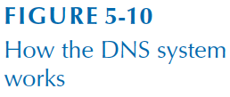
Network Layer Functions

Slide 21
Network Layer Functions
Routing
Process of identifying what path to have a packet take through a network from sender to receiver
Routing Tables
Used to make routing decisions
Shows which path to send packets on to reach a given destination
Kept by computers making routing decisions
Routers
Special purpose devices used to handle routing decisions on the Internet
Maintain their own routing tables
Dest. | Next
B | B
C | B
D | D
E | D
F | D
G | B

Slide 22
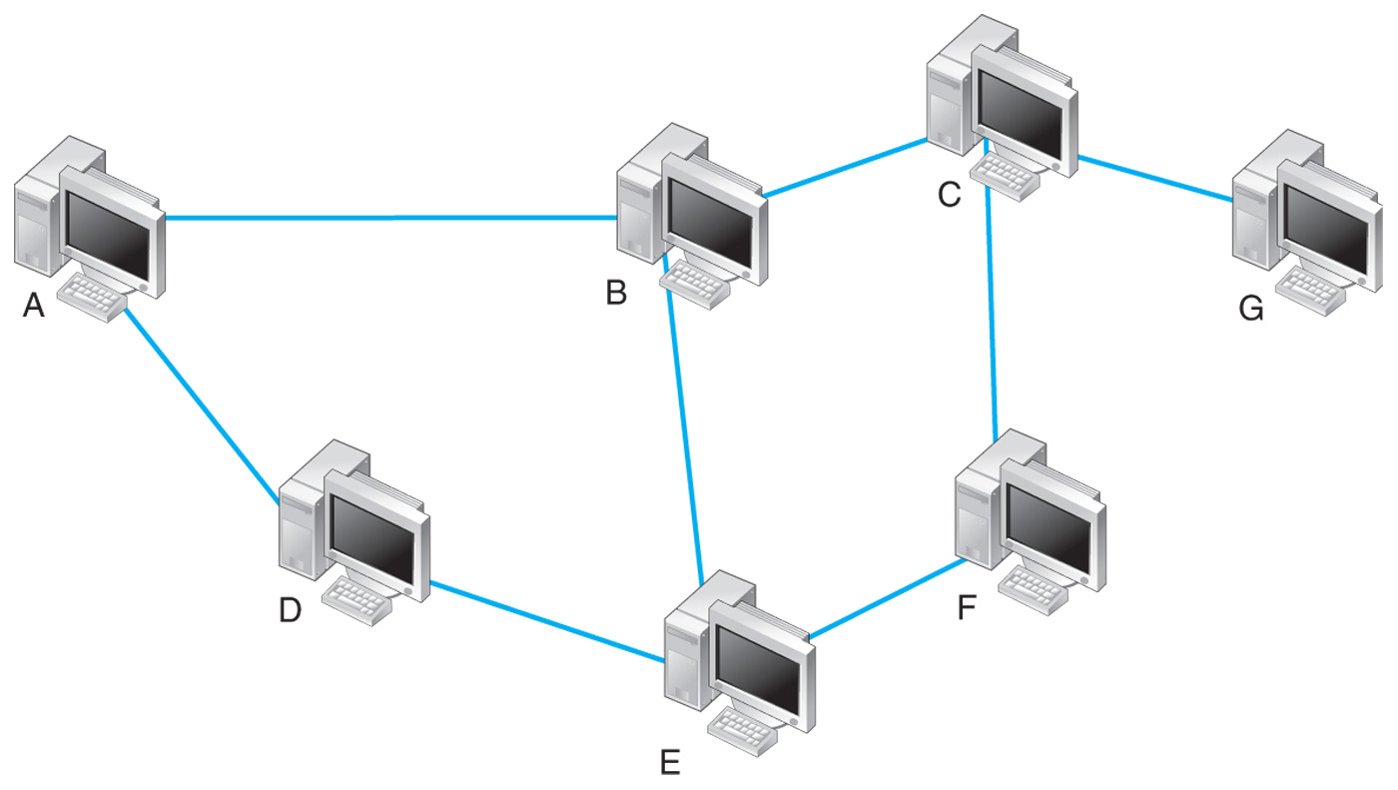
Routing
What are the possible paths from A to G?
ABCG
ABEFCG
ADEFCG
ADEBCG
Simplified Routing Table for A
Dest. | Next
B | B
C | B
D | D
E | D
F | D
G | B

Slide 23
10.10.51.x
10.10.52.x
1
1
2
4
2
4
3
3
INTERNET
10.10.53.x
BN 10.10.250.x
1
2
2
Simplified Routing Table
Destination | Interface
1
Destination | Interface
10.10.70.x | 1
0.0.0.0 | 2
10.10.34.x
2
1
10.10.70.x

Slide 24
10.10.51.x
10.10.52.x
1
1
2
4
2
4
3
3
INTERNET
10.10.53.x
BN 10.10.250.x
1
2
2
Simplified Routing Table
Destination | Interface
Destination | Interface
10.10.51.x | 1
10.10.52.x | 2
10.10.34.x | 3
0.0.0.0 | 4
Destination | Interface
10.10.51.x | 1
10.10.52.x | 2
10.10.34.x | 3
10.10.53.x | 2
10.10.70.x | 2
0.0.0.0 | 4
Destination | Interface
10.10.51.x | 1
10.10.52.x | 2
10.10.34.x | 3
10.10.53.x | 2
10.10.70.x | 2
10.10.250.34 | 3
10.10.250.x | 2
0.0.0.0 | 4
1
10.10.34.x
2
1
10.10.70.x

Slide 25
Routing
Centralized Routing
Routing decisions made by one computer
Not common anymore
Decentralized Routing
Decisions made by each node independently of one another
Information needs to be exchanged to prepare routing tables
Used by the Internet

Slide 26
Routing
Static
Fixed routing tables
Manually configured by network managers
Local adjustments when computers added or removed
Dynamic
Routing tables updated periodically
Routers exchange information using protocols to update tables

Slide 27
Routing
Dynamic routing algorithms
Distance vector: based on the number of “hops” between two devices
Link state: based on the number of hops, circuit speed, and traffic congestion
Provides more reliable, up to date paths to destinations

Slide 28
Routing Protocols
Routing Information Protocol (RIP)
Dynamic distance vector protocol used for interior routing
Operation
Network manager builds the routing table
Routing tables broadcast periodically (e.g., every minute or so)
When new computers are added, router counts “hops” and selects the shortest route
Useful in smaller, less complex networks

Slide 29
Routing Protocols
Open Shortest Path First (OSPF)
Dynamic link state protocol used for interior routing
Most widely used interior routing protocol on large enterprise networks
More reliable paths
Less burdensome to the network because only updates sent

Slide 30
Routing Protocols
Enhanced Interior Gateway Routing Protocol (EIGRP)
A dynamic link state protocol (developed by Cisco)
Records transmission capacity, delay time, reliability and load for all paths
Keeps the routing tables for its neighbors and uses this information in its routing decisions as well

Slide 31
Routing Protocols
If each network uses a different protocol internally, how are they able to communicate?
Border Gateway Protocol (BGP)
Dynamic distance vector protocol used for exterior routing
Far more complex than interior routing protocols
Provide routing info only on selected routes (e.g., preferred or best route)

Slide 32
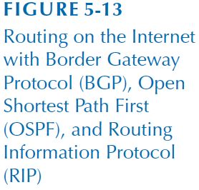

Slide 33
Multicasting
Unicast - one computer to another computer
Broadcast - one computer to all computers in the network
Multicast - one computer to a group of computers (e.g., videoconference)
Same data needs to reach multiple receivers and avoid transmitting it once for each receiver
Particularly useful if access link has bandwidth limitations
Many implementations at different layers
In IP multicast, hosts dynamically join and leave multicast groups using Internet Group Management Protocol (IGMP)

Slide 34
TCP/IP Example
Required network addressing information:
Device’s own IP address
Subnet mask
IP address of default gateway (most commonly the router)
IP address of at least one DNS server
Obtained from a configuration file or DHCP

Slide 35
Known Addresses, Same Subnet
Suppose we have an HTTP request from Client in building A to Server in building B.

Slide 36
TCP/IP Examples
A Client (128.192.98.130) requests a Web page from a server (www1.anyorg.com)
Client knows the server’s IP
A Client (128.192.98.130) requests a Web page from a server (www2.anyorg.com) on a different subnet
Client knows the server’s IP
A Client (128.192.98.130) requests a Web page from a server (www1.anyorg.com)
Client does not know server’s IP

Slide 37
TCP/IP and Layers
Host Computers
Packets move through all layers
Gateways, Routers
Packet moves from Physical layer to Data Link Layer through the network Layer
At each stop along the way
Ethernet packets is removed and a new one is created for the next node
IP and above packets never change in transit (created by the original sender and destroyed by the final receiver)

Slide 39
Implications for Management
Organizations standardizing on TCP/IP
Decreases costs of equipment and training
Network providers are also moving towards standardization
Slow transition to IPv6

