Slide 1
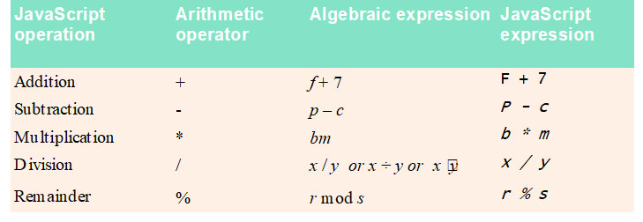
Arithmetic Operators

Slide 2
Precedence of Arithmetic Operators

Slide 3
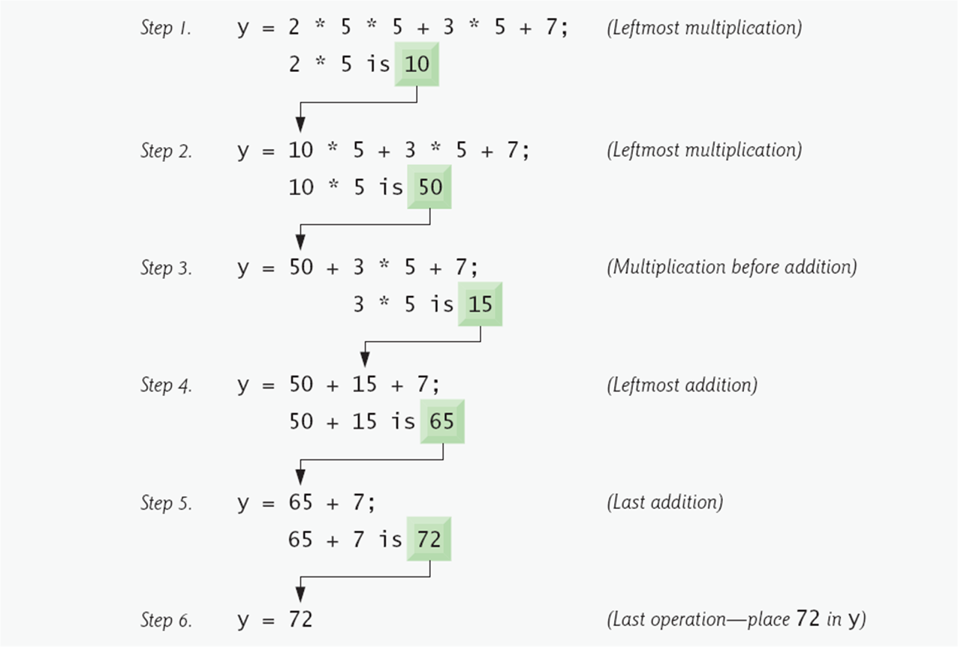
Precedence of Arithmetic Operators

Slide 4
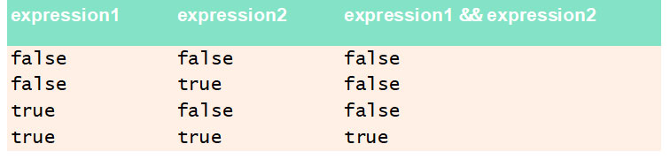
Logical AND Operator

Slide 5
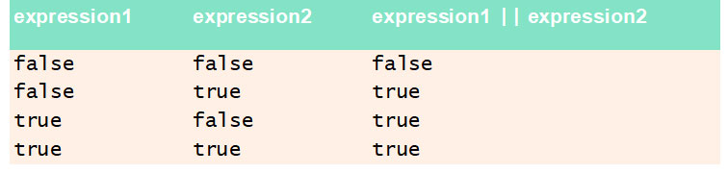
Logical OR Operator

Slide 6
Equality and Relational Operators

Slide 7
Precedence and Associativity of the Operators

Slide 8
Assignment Operators

Slide 9
Increment and Decrement Operators

